Slide 1
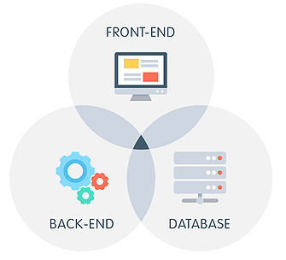

Full Stack web development
Capabilities
Flairminds
Innovation, Resilience, Efficiency

Slide 2

Content
What is Full Stack Web Development:
Introduction to Full Stack development
Potential value additions
Flairminds’ approach:
Approach at Flairminds
Tools and technological capabilities at Flairminds
Confidential - Work Document

Slide 3
Introduction to Full Stack development

Slide 4
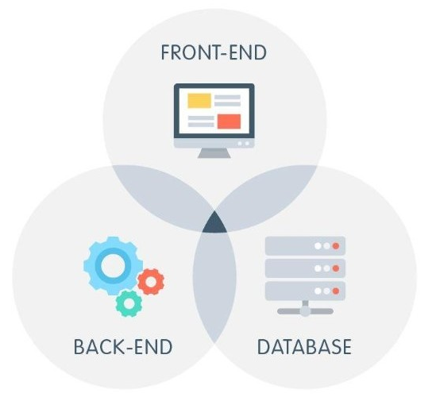
What is Full Stack Development?
Full stack development refers to the end-to-end application software development, including the front end and back end. The front end consists of the user interface, and the back end takes care of the business logic and application workflows.
The website UI can be built using various, front-end technologies like HTML, CSS, Javascript along with latest frontend frameworks like Bootstrap, ReactJS, VueJS etc.
The back end consists of logic that can connect the application to other services and databases. For example, all the user and transaction data is stored in a database through specific drivers handled on the back end.
Confidential - Work Document

Slide 5
Benefits of Full Stack development
Cost-efficient:
Saves both time and money, as a full-stack developer is able to work on both the front-end and back-end
Increased efficiency & flexibility:
Manages both backend and frontend development simultaneously enhancing productivity timely delivery.
Businesses can be more agile; they can quickly adapt to changes in the marketplace.
Complete ownership and understanding of the project
Easy knowledge transfer to other team members
Better division of work amongst team members
Improved scalability:
Allows to handle increased loads or traffic without having to make significant changes to their applications
Faster time to market:
Reduces the amount of time that they spend on development projects.
Provides an all-in-one solution to all aspects of software development.
Faster bug fixing due to knowledge of complete system
Enhances productivity
Confidential - Work Document

Slide 6
Services portfolio @ Flarminds
Development CONSULTANCY:
Whether you are creating a new product, or want an expert opinion on your current architecture, Flairminds can help with best architects, or set up the infrastructure plan reducing complexities and cost while delivering quality.
FRONT-END:
Front-end development is focused on the look and feel of the website or application and includes everything from the layout and design to the user interface and user experience.
Some of the commonly used front-end development tools include HTML, CSS, and JavaScript.
Other latest front-end frameworks and libraries can make development of the UI richer and easier, such as Bootstrap and ReactJS. NextJS offers additional features on top for a richer development. Libraries such as MaterialUI and NextUI offers readymade and customizable UI components for ease of development.
BACK-END:
Back-end development is responsible for all of the behind-the-scenes functionality. This is known as the server-side layer of the application.
Back end development focuses on the logic of the site, creating servers, and working with databases and API's.
One of the most common back-end development tool like Node.js which is a popular Javascript runtime environment.
There are also a number of back-end frameworks and libraries that can make development easier, such as Laravel and Express.
DATABASE:
A database can act as a primary collection of data. Working with data involves various functions such as insertion, deletion, and modification of data and the retrieval of the updated data.
SQL-based databases such as MySQL, PostgreSQL and MS-SQL are some of the database management systems. Developers follow relational database models and the techniques.
NoSQL databases such as MongoDB is also popular with JS-based stack due to its flexibility of schema and ease of insertion.. NoSQL basically translates to a non-relational database model for storage.
Confidential - Work Document

Slide 7
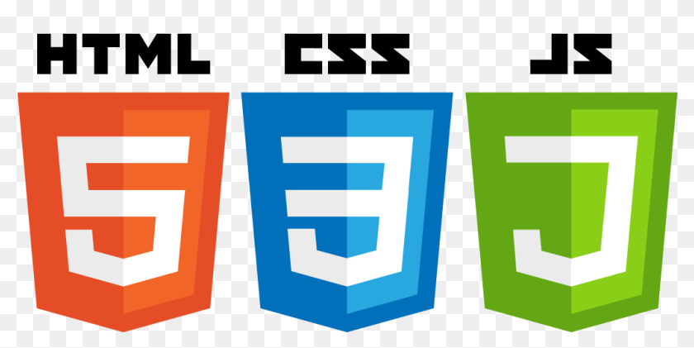






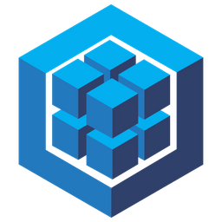







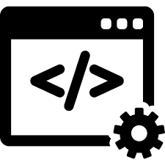





Ecosystem & services @ Flairminds
Ecosystem:
Services:
Discussion Forums
Commercial Websites
Resource Directories
Community Web Portals
E-commerce Application
CMS Websites
Frontend
Backend
Database
Dynamic Web Development
Static Web Development
Corporate Web Development
Mobile
Platforms
Tools
Confidential - Work Document

Slide 8




Contact
PUNE OFFICE
FlairMinds Software Pvt. Ltd. 11, Soormani, 163 D.P.Road, Aundh, Pune, opposite DAV School, 411007, India
NAGPUR OFFICE
Infosane Technologies llp Nagpur, Shop No. 168, RAJAT SANKUL Opp. S.T. Stand, Near Hotel Rahul Deluxe GANESH PETH, Nagpur, Maharashtra 441108,India
sales@flairminds.com
+91 9967 650 472
FlairMinds
Confidential - Work Document

